Slide 1

CAPSTONE PROJECT Sentiment Analysis of Movie Reviews using AI
Presented By
Student Name: Vanshika B R
College Name: GM Institute of Technology
Department: AI & ML
Email ID: vanshikabottolaNDA@GMAIL.COM
AICTE Student ID: STU67f86634464ef1744332340

Slide 2
OUTLINE
Problem Statement Proposed System/Solution
System Development Approach (Technology Used)
Algorithm & Deployment
Result
Conclusion
Future Scope
References

Slide 3
Problem Statement
With the increasing number of movie reviews published online, it becomes difficult for users and platforms to understand public opinion quickly. Manually going through thousands of reviews is time-consuming and subjective. There is a need for an automated system to classify the sentiment of reviews as positive or negative.

Slide 4
Proposed Solution
Data Collection:
Used NLTK's movie_reviews dataset with 2000 reviews.
Reviews are labeled as positive or negative.
Each review consists of tokenized text data.
Data Preprocessing:
Converted text to lowercase and removed stop words.
Extracted 2000 most frequent words as features.
Machine Learning Algorithm:
Used Naive Bayes classifier for sentiment classification.
Model trained on 1900 samples, tested on 100 samples.
Chosen for simplicity, speed, and performance with text data.

Slide 5
Deployment:
Developed using Python in Google Colab (no setup needed).
All files and code uploaded to GitHub.
Project designed as a backend model demonstration.
Evaluation:
Achieved 80% accuracy on the test dataset.
Used nltk.classify.accuracy() for performance evaluation.
Extracted top informative words using .show_most_informative_features().
Result:
The model achieved 80% accuracy in classifying movie reviews into positive or negative using Naive Bayes on the NLTK dataset.

Slide 6
System Approach
This project follows a machine learning-based NLP approach to analyze movie review sentiments. The system was implemented using Python tools and libraries for building and testing the model.
Applied Natural Language Processing (NLP) techniques to analyze movie reviews.
Converted review text into numerical features using word frequency.
Used Naive Bayes classifier to predict sentiment as positive or negative.
Implemented the entire workflow using Python in Google Colab.
Achieved 80% accuracy on test data using NLTK’s movie_reviews dataset.

Slide 7
Algorithm & Deployment
The project uses a machine learning-based classification approach to analyze movie review sentiments and predict polarity based on word frequency features.
Algorithm Selection:
Chosen Algorithm: Naive Bayes Classifier (Multinomial)
Justification: This algorithm works well for text classification tasks where features are word frequencies. It's fast, easy to implement, and performs effectively on structured text like movie reviews.
Data Input:
Input Features: Binary indicators for the presence of top 2000 frequent words extracted from reviews.
Labels: Each review is pre-labeled as positive or negative in the NLTK movie_reviews dataset.

Slide 8
Training Process:
The dataset was split into training (1900) and testing (100) samples.
Each review was converted into a feature vector using a custom function to check for the presence of frequent words.
The classifier was trained on these vectors using NLTK’s training function.
Prediction Process:
After training, the classifier predicts whether new/unseen reviews are positive or negative.
The prediction is based on the learned patterns of word presence from the training data.
The system outputs sentiment class and highlights most informative words influencing decisions.

Slide 9
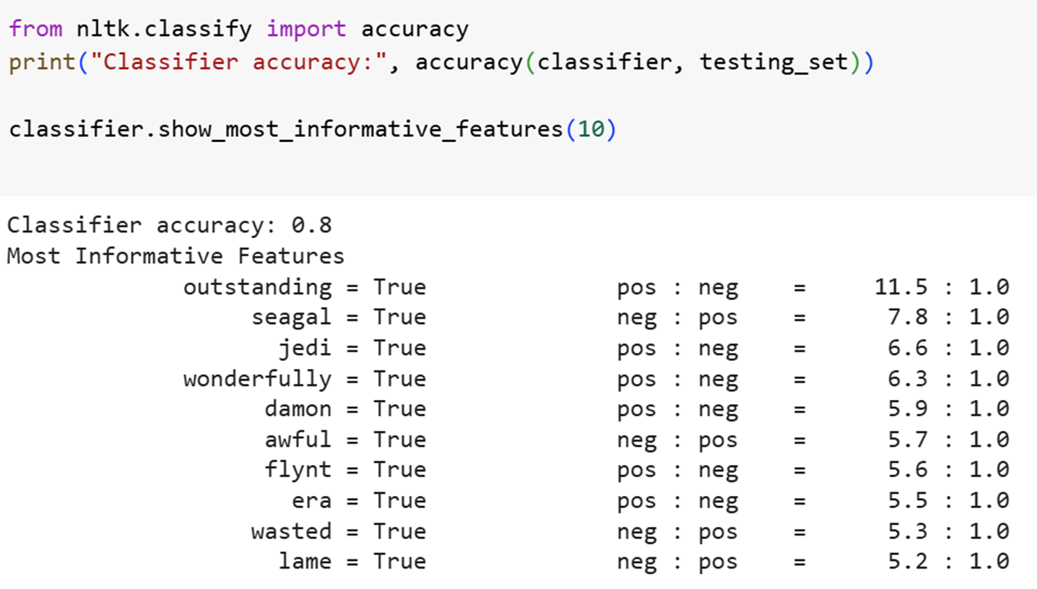
Result
The Naive Bayes classifier achieved an accuracy of 80% on the test dataset.
The model effectively classified movie reviews into positive and negative categories.
Positive words identified: “outstanding”, “wonderfully”, “jedi”
Negative words identified: “awful”, “lame”, “wasted”, “seagal”
Visuals included:
Code output showing accuracy
Top 10 informative features from the model
Sample input review and label

Slide 10
Conclusion
The sentiment analysis model developed in this project successfully classified movie reviews into positive or negative categories using Natural Language Processing and a Naive Bayes classifier. With an accuracy of 80%, the system demonstrated the effectiveness of applying machine learning to real-world text data. While challenges were encountered during preprocessing, such as handling stop words and extracting relevant features, the final results were promising. This project highlights the potential of AI-driven text classification and sets the foundation for future enhancements using more advanced models and larger datasets.

Slide 11
Future scope
Expand the dataset by including real-time reviews from platforms like IMDb, Amazon, or Rotten Tomatoes.
Upgrade the model using advanced algorithms like LSTM, GRU, or BERT for deeper contextual understanding.
Convert the project into a web or mobile app that performs live sentiment prediction.
Deploy the model using cloud platforms (like Azure or AWS) for scalability and faster response.
Explore edge computing for offline sentiment detection in low-connectivity regions.

Slide 12
References
NLTK – Natural Language Toolkit Documentation https://www.nltk.org/
Sentiment Analysis with Naive Bayes – GeeksforGeeks https://www.geeksforgeeks.org/sentiment-analysis-using-naive-bayes-classifier/
Naive Bayes Classifier – Scikit-learn Documentation https://scikit-learn.org/stable/modules/naive_bayes.html
Google Colab – Cloud-based Python Notebook https://colab.research.google.com/
GitHub Link:
https://github.com/vanshika-1304/sentiment-analysis-ai-project

Slide 13
Thank you

